Slide 1
Love as a way of life
By Sara Tarek
14 Feb. 2010-Love as a way of life- Sara Tarek

Slide 2
Dr. Gary Chapman
The Five Love Languages, Northfield Publishing,* Chicago, 1992, 1995.
Love Talks for Families, Northfield Publishing, 2002.
The Family You’ve Always Wanted, Northfield Publishing, 2008.
Love As A Way of Life, WaterBrook Press, 2008.
Love is A Verb, WaterBrook Press, 2009.

Slide 3
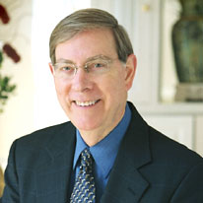
“The quality of any society is defined by the behavior of people with each others, in the street, at work, at school and finally in the family. The quality of these relationships between people defines who we are, and can govern our happiness, success and personal fulfillment.” Dr. Gary Chapman

Slide 4
Kindness: discovering the joy of helping others
Patience: accepting the imperfections of others
Forgiveness: finding freedom from the grip of anger
Courtesy: treating others as friends
Humility: stepping down so someone else can step up
Generosity: giving your time, money, and abilities to others
Honesty: caring enough to tell the truth

Slide 5
Kindness: discovering the joy of helping others

Slide 6
Courtesy: treating others as friends
Don’t wait for people to be friendly…Show them How !!

Slide 7
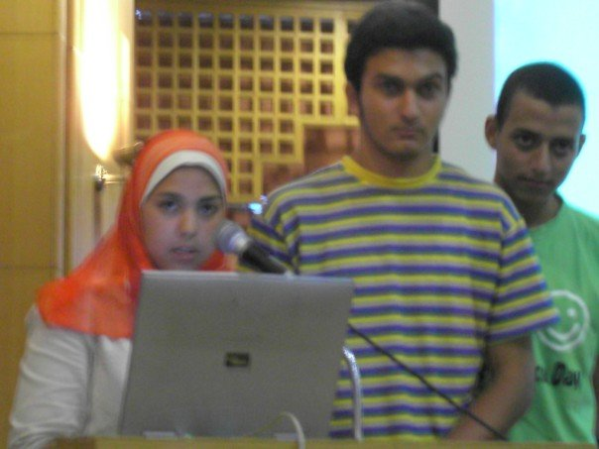
Patience: accepting the imperfections of others

Slide 8
Forgiveness: finding freedom from the grip of anger

Slide 9
Humility: stepping down so someone else can step up

Slide 10
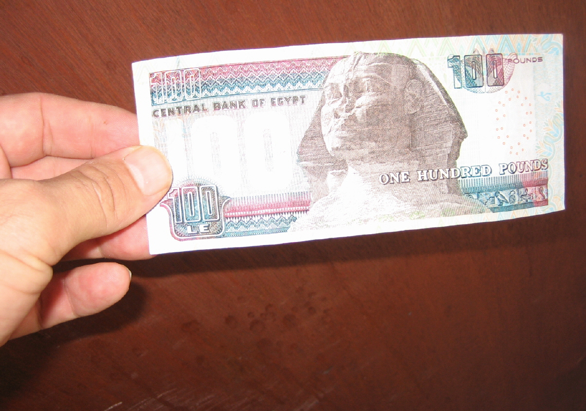
Generosity: giving your time, money, and abilities to others

Slide 11
Honesty: caring enough to tell the truth

Slide 12
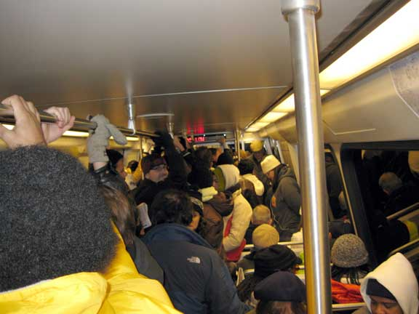
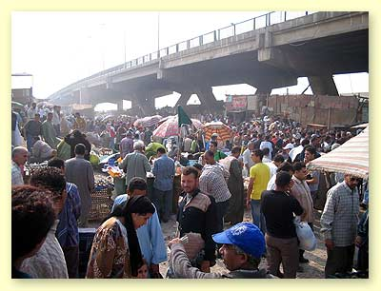
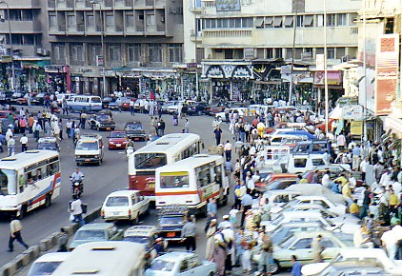

Slide 13
www.garychapman.org

